Slide 1



Slide 2
F.I.R.E. FOR EFFECT
A Military Financial Readiness Tool
OA3801 Final Project
Finance is boring. Do it once, get it right, and move on.
F.I.R.E. for Effect | OA3801
Notes:
Ian owns this

Slide 3
THE PROBLEM
The most complex compensation structure in any employment sector — and no single tool to decode it
~25%
2x
#1 Reason
Food Insecure
Payday Loan Use
For Clearance Denials
of active-duty members experience food insecurity — over 2x the civilian rate
more likely than civilians to take out a predatory payday loan (up to 36% interest)
Financial problems are #1 reason for revoked or denied clearances
RAND / DoD SOFS-A
DoD Report to Congress/CFPB
UCMJ.us
The Problem Isn’t the Paycheck
The Consequences
Compensation exceeds the 83rd percentile of comparable civilian earnings, but with BAH, BAS, Base Pay, Special Pay, pension, and VA benefits most never fully understand there is no single tool translates all of it into clear answers:
Less than 50% of BRS-enrolled SMs capture full DoD 5% match
AVG enlisted member separates with <$10K in TSP savings
Financial distress threatens security clearances, retention, and readiness — an OPSEC vulnerability
What do I make?
What do I need to save?
Where does it go?
F.I.R.E. for Effect | OA3801
2
Notes:
Add personal experience financial readiness, that don't know but would like to be educated: Target market and solution.

Slide 4
THE SOLUTION?
A one-stop financial readiness tool that gets service members to an 80% financial solution—or at least on the path—in 30 minutes.
Understand what you make.
What do you need to save to achieve your goals?
Where is it going (and/or how to seal the financial sucking chest wound)?
F.I.R.E. for Effect | OA3801
2
Notes:
Add personal experience financial readiness, that don't know but would like to be educated: Target market and solution.

Slide 5
THE DATA WE NEEDED
Six data sources, five different formats, one JSON
Data Source | What | Raw Format | Python Method
DFAS Pay Chart | Base pay for all ranks & TIS | PDF | pdfplumber -> pandas
BAH Rate Tables | All ranks, ~300 MHAs, w/ & w/o deps | Comma-delimited ASCII | pandas.read_csv()
ZIP -> MHA Crosswalk | 40,000 zip codes merged with MHA | Space-delimited ASCII | pandas.read_csv(sep=' ')
MHA Names | Human-readable location labels | Semicolon-delimited ASCII | pandas.read_csv(sep=';')
TSP Fund History | Monthly returns since inception | API (TSP.gov / Yahoo) | yfinance -> proxy data
BAS / Special Pays | Officer & enlisted food allowance | Manual lookup | Hardcoded in configuration planning
Pay: All pay data aggregated into a single military_data.json via a one-time build script. 2M+ data points compiled.
Finance: API for TSP fund monthly fund change, market proxy data from yfinance alternate, avg/st-dev random sampling tertiary.
F.I.R.E. for Effect | OA3801
3
Notes:
Ian own

Slide 6
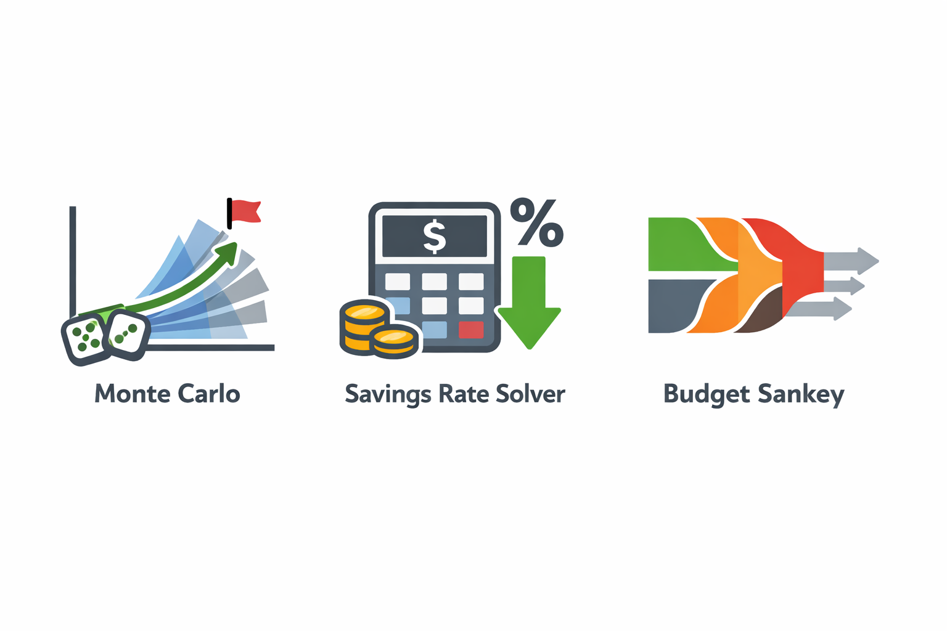
THREE CORE ENGINES
The computational backbone
Savings Rate Solver
Monte Carlo Simulator
Cash Flow Sankey
1,000 independent trials
Normal(μ, σ) draws per fund, per month, per trial
Dynamic contributions: shifts as pay changes based on % of base pay
Convert nominal → real returns (inflation-adjusted)
Outputs: Median/P10/P90 bands + success probability
Binary search: 60 iterations over 0–100% for a rate that achieves savings rate given a compounding formula
Promotion-aware income schedule
Multiple progression chains: Enlisted, Warrant, Officer, Prior-E
Mirrors Monte Carlo allocation logic/user selection
Gross → Taxes → Take-Home → Fixed / Invest / Guilt-Free / Surplus
Node width proportional to actual dollar flow
LES-mode or formula-mode input
Deficit detection with red warning
Plotly go.Sankey, dark theme
F.I.R.E. for Effect | OA3801
4
Notes:
Shaun
The Monte Carlo simulation doesn't work in isolation — it's one of three engines that work together. The first is the Savings Rate Solver. It uses a binary search to find the exact percentage of base pay a service member needs to save, accounting for their projected promotion timeline and post-military civilian income. That percentage and the contribution schedule it produces become the direct input to the second engine — the Monte Carlo simulation itself. The MC runs 1,000 independent trials, each drawing fresh random returns from a Normal distribution calibrated to each TSP fund's historical performance. The key word is 'independent' — every trial, every fund, every month gets its own draw, which eliminates the sampling bias we saw in earlier versions.

Slide 7
THREE CORE ENGINES
The computational backbone: user inputs to personalized financial intelligence
Monte Carlo Simulation
Savings Rate Solver
Cash Flow Sankey
1,000 independent trials
Normal(μ, σ) draws per fund, per month, per trial
Dynamic contributions: shifts as pay changes based on % of base pay
Convert nominal → real returns (inflation-adjusted)
Outputs: Median/P10/P90 bands + success probability
Binary search: 60 iterations over 0–100% for a rate that achieves savings rate given a compounding formula
Promotion-aware income schedule
Multiple progression chains: Enlisted, Warrant, Officer, Prior-E
Mirrors Monte Carlo allocation logic/user selection
Gross → Taxes → Take-Home → Fixed / Invest / Guilt-Free / Surplus
Node width proportional to actual dollar flow
LES-mode or formula-mode input
Deficit detection with red warning
Plotly go.Sankey, dark theme
F.I.R.E. for Effect | OA3801
4
Notes:
Shaun
The Monte Carlo simulation doesn't work in isolation — it's one of three engines that work together. The first is the Savings Rate Solver. It uses a binary search to find the exact percentage of base pay a service member needs to save, accounting for their projected promotion timeline and post-military civilian income. That percentage and the contribution schedule it produces become the direct input to the second engine — the Monte Carlo simulation itself. The MC runs 1,000 independent trials, each drawing fresh random returns from a Normal distribution calibrated to each TSP fund's historical performance. The key word is 'independent' — every trial, every fund, every month gets its own draw, which eliminates the sampling bias we saw in earlier versions.

Slide 8
THREE CORE ENGINES
The computational backbone: user inputs to personalized financial intelligence
Monte Carlo Simulation
Savings Rate Solver
Cash Flow Sankey
1,000 independent trials
Normal(μ, σ) draws per fund, per month, per trial
Dynamic contributions: shifts as pay changes based on % of base pay
Convert nominal → real returns (inflation-adjusted)
Outputs: Median/P10/P90 bands + success probability
Binary search: 60 iterations over 0–100% for a rate that achieves savings rate given a compounding formula
Promotion-aware income schedule
Multiple progression chains: Enlisted, Warrant, Officer, Prior-E
Mirrors Monte Carlo allocation logic/user selection
Output: a single % to plug into MyPay for entire career (if career doesn’t stall)
Gross → Taxes → Take-Home → Fixed / Invest / Guilt-Free / Surplus
Node width proportional to actual dollar flow
LES-mode or formula-mode input
Deficit detection with red warning
Plotly go.Sankey, dark theme
F.I.R.E. for Effect | OA3801
4
Notes:
Each own own piece

Slide 9
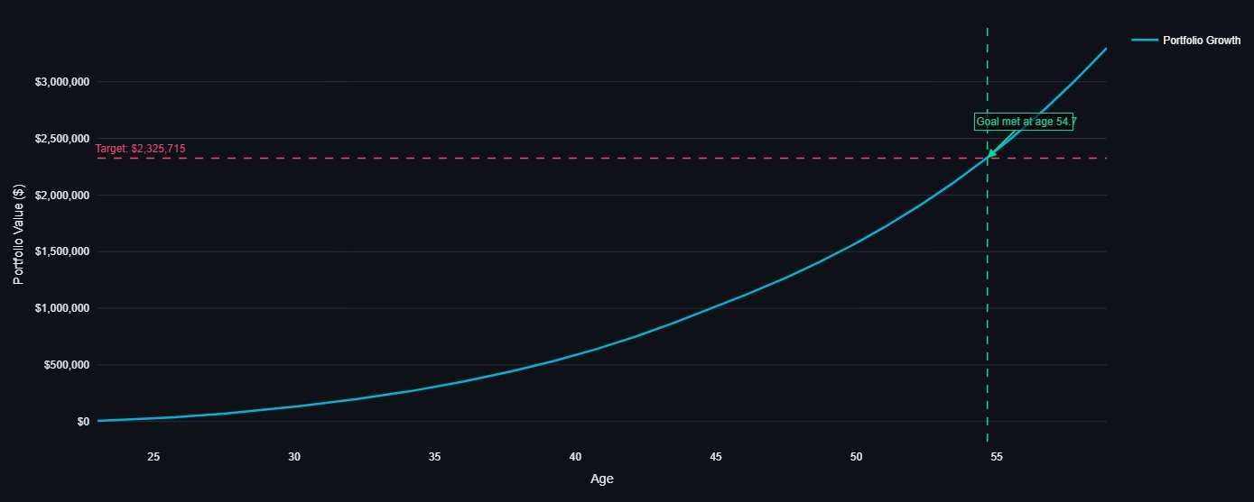
DATA FLOW: INPUTS TO OUTPUT
How user inputs become a personalized Monte Carlo visualization
1. DATA INPUTS
2. PROCESSING & SIMULATION
3. RENDERED OUTPUT
User Inputs
Savings Rate Solver
Streamlit Display
Current Age/Rank/TIS, Pension Rank/TIS, Retire Age, Current TSP, Desired Retirement Income, Expected Post-Military Salary,
Fund Allocation, Inflation Rate
Given required Nest Egg, known current balance, and projected income and interest from allocations, determine % of base pay that will achieve nest egg. Uses Bisection Method that we learned in COMP 1
,
External Data
TSP Fund Statistics
Military Pay & Expected Promotion Schedule Data (JSON)
Statistical Analysis
Visualization (plotly)
Interactive plotly with:
• Time to success
P10/P50/P90 percentiles
Success probability
(% trials ≥ target)
20 sample paths (gray)
Percentile bands (fill)
Target line (dashed red)
Solver Output
Savings Rate % required to achieve nest egg
Corrected from original flowchart: Statistical Analysis and Visualization Generation happen in parallel after simulation completes, not sequentially.
Notes:
Shaun
The Monte Carlo simulation doesn't work in isolation — it's one of three engines that work together. The first is the Savings Rate Solver. It uses a binary search to find the exact percentage of base pay a service member needs to save, accounting for their projected promotion timeline and post-military civilian income. That percentage and the contribution schedule it produces become the direct input to the second engine — the Monte Carlo simulation itself. The MC runs 1,000 independent trials, each drawing fresh random returns from a Normal distribution calibrated to each TSP fund's historical performance. The key word is 'independent' — every trial, every fund, every month gets its own draw, which eliminates the sampling bias we saw in earlier versions.
This slide shows the end-to-end data flow from user inputs to the chart they see.
On the left — three categories of inputs feed the simulation. The user enters their age, TSP balance, fund allocation, and inflation assumption. External data provides fund return statistics and military pay tables. And the solver output from the previous slide delivers the month-by-month contribution schedule — that's the critical link between the two engines.
In the center — everything feeds into run_real_monte_carlo. It generates 1,000 independent trials, each drawing fresh Normal distribution returns per fund, per month. After the simulation completes, two things happen in parallel: statistical analysis computes the percentiles and success probability, while matplotlib builds the visualization — 20 sample paths, the P10-to-P90 shaded band, and the target line.
On the right — that renders into the Streamlit display. The chart persists across widget reruns using session state, so the user doesn't lose their simulation when they interact with other parts of the app.

Slide 10
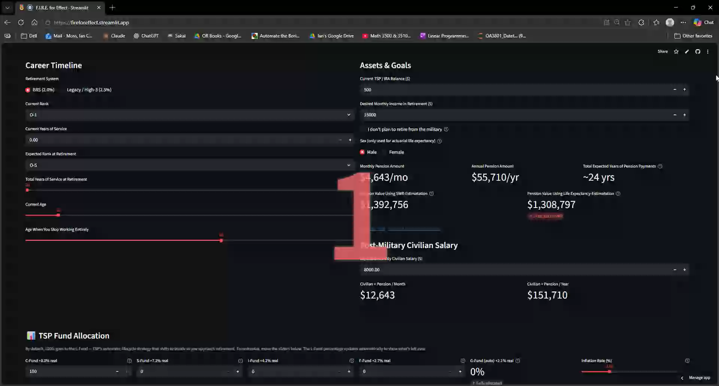

Slide 11
SAVINGS RATE SOLVER
Given a retirement goal, figure out the single number you plug into MyPay to get there.
How it works:
Binary search/Bi-Section Method (60 times) over 0–100% savings rate. Uses month-by-month allocation identical to Monte Carlo — always calibrated.
Why it matters:
One actionable % to plug into MyPay and post-military to meet retirement goal.
F.I.R.E. for Effect | OA3801
6

Slide 12
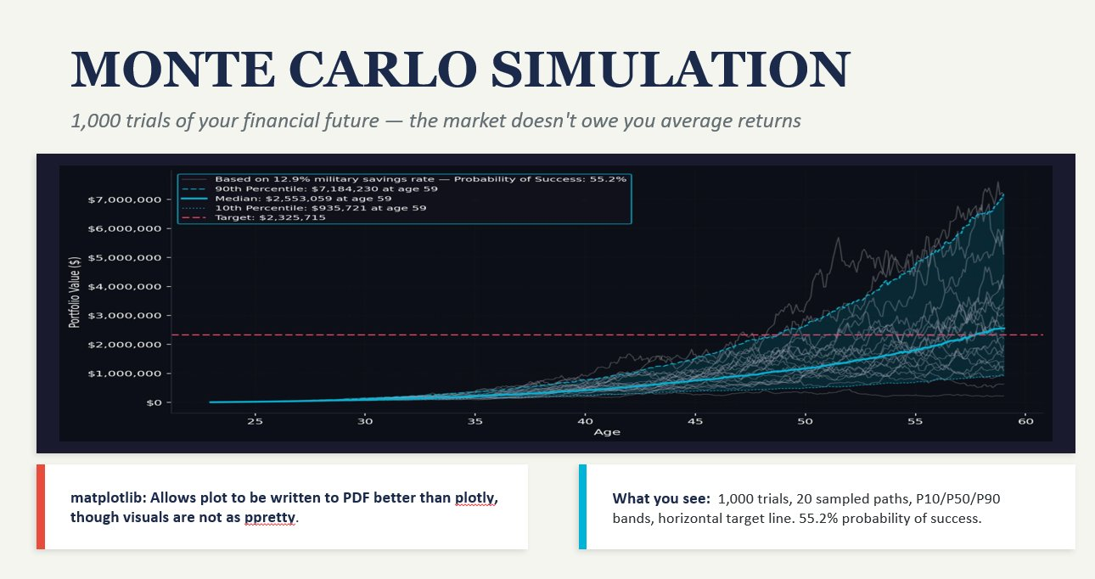
DATA FLOW: INPUTS TO OUTPUT
How user inputs become a personalized Monte Carlo visualization
1. DATA INPUTS
2. PROCESSING & SIMULATION
3. RENDERED OUTPUT
User Inputs
Monte Carlo Simulation
Streamlit Display
Current Age, Retire Age, Current TSP,
Fund Allocation, Inflation Rate
run_real_monte_carlo()
Generates 1,000 path arrays of projected portfolio
balance, applying random Normal(μ,σ) returns
per fund per month + user contributions
External Data
TSP Fund Statistics (tspfolio.com)
Military Pay & Promotion Data (JSON)
Statistical Analysis
Visualization (Matplotlib)
Static fan chart with:
• Success rate in legend
• Savings rate label
• Persists across widget reruns
P10/P50/P90 percentiles
Success probability
(% trials ≥ target)
20 sample paths (gray)
Percentile bands (fill)
Target line (dashed red)
Solver Output
Savings Rate %, Contribution
Schedule (monthly $ amounts)
Notes:
Shaun
The Monte Carlo simulation doesn't work in isolation — it's one of three engines that work together. The first is the Savings Rate Solver. It uses a binary search to find the exact percentage of base pay a service member needs to save, accounting for their projected promotion timeline and post-military civilian income. That percentage and the contribution schedule it produces become the direct input to the second engine — the Monte Carlo simulation itself. The MC runs 1,000 independent trials, each drawing fresh random returns from a Normal distribution calibrated to each TSP fund's historical performance. The key word is 'independent' — every trial, every fund, every month gets its own draw, which eliminates the sampling bias we saw in earlier versions.
This slide shows the end-to-end data flow from user inputs to the chart they see.
On the left — three categories of inputs feed the simulation. The user enters their age, TSP balance, fund allocation, and inflation assumption. External data provides fund return statistics and military pay tables. And the solver output from the previous slide delivers the month-by-month contribution schedule — that's the critical link between the two engines.
In the center — everything feeds into run_real_monte_carlo. It generates 1,000 independent trials, each drawing fresh Normal distribution returns per fund, per month. After the simulation completes, two things happen in parallel: statistical analysis computes the percentiles and success probability, while matplotlib builds the visualization — 20 sample paths, the P10-to-P90 shaded band, and the target line.
On the right — that renders into the Streamlit display. The chart persists across widget reruns using session state, so the user doesn't lose their simulation when they interact with other parts of the app.

Slide 13
55.2%
Probability of Success
Why matplotlib? Pixel-level control for 1,000 overlapping paths. Plotly can't render this density without lag. Matplotlib also writes directly to the PDF export.
What you see: 20 sampled paths (gray), P10/P50/P90 percentile lines, shaded 80% confidence band, red dashed target nest egg line.
Notes:
Shaun
This is what the user sees. Each gray line is one possible future — same plan, same savings rate, same fund allocation, completely different outcome based on nothing but market timing. The solid cyan line is the median — the 50th percentile outcome. The shaded band covers the 10th to 90th percentile range, so 80% of simulated futures land inside that band. The red dashed line is the target nest egg — in this case, about $2.3 million in today's dollars. The probability of success here is 55.2%, which means roughly half of the simulated market histories got this service member to their goal. That might sound low, but it's intentional. A 50-60% success rate for someone with a military pension floor is a realistic, balanced plan — targeting 80-90% would mean over-saving in most scenarios. The chart is rendered in matplotlib because Plotly can't handle 1,000 overlapping paths without lag, and matplotlib can be written directly into the PDF export on Tab 6

Slide 14
VISUALIZATIONS
What each visualization reveals and the technical choices that make it speak
Monte Carlo Fan Chart
Savings Rate Explorer
Cash Flow Sankey
Matplotlib
Plotly (go.Scatter)
Plotly (go.Sankey)
WHAT IT SHOWS
WHAT IT SHOWS
WHAT IT SHOWS
1,000 simulated paths, 20 sampled by percentile, P10/P50/P90 band overlay, horizontal target line
Deterministic growth curve with dashed target. Animated vertical intercept annotation when goal age is found.
Gross → Taxes + Take-Home → Fixed / Invest / Guilt-Free / Surplus. Node width proportional to dollar flow.
WHAT WE LEARNED
WHAT WE LEARNED
WHAT WE LEARNED
Matplotlib gives pixel-level control. Plotly can't render 1,000 overlapping paths without lag. facecolor + spines = dark mode.
add_vline() + add_annotation() with ax/ay offsets creates callout arrows. Plotly dark theme via plot_bgcolor.
Sankey forces users to confront budget leaks visually — a table never could. template='plotly_dark' essential.
F.I.R.E. for Effect | OA3801
9
Notes:
Shaun own
Two visualizations work in tandem. The Savings Rate Explorer on the right is deterministic — it shows a single smooth growth curve based on the expected blended return. It answers the question: 'If everything goes exactly as expected, when do I hit my goal?' The Monte Carlo fan chart on the left is the reality check. Same savings rate, same allocation — but now with 1,000 different market histories applied. The Explorer gives you the plan. The fan chart shows you what the plan actually looks like when the market doesn't cooperate. The design choice to use matplotlib for the MC and Plotly for the Explorer was deliberate — matplotlib gives us the pixel-level control needed for dense overlapping paths, while Plotly's interactivity lets users drag a slider and see the growth curve update in real time.

Slide 15
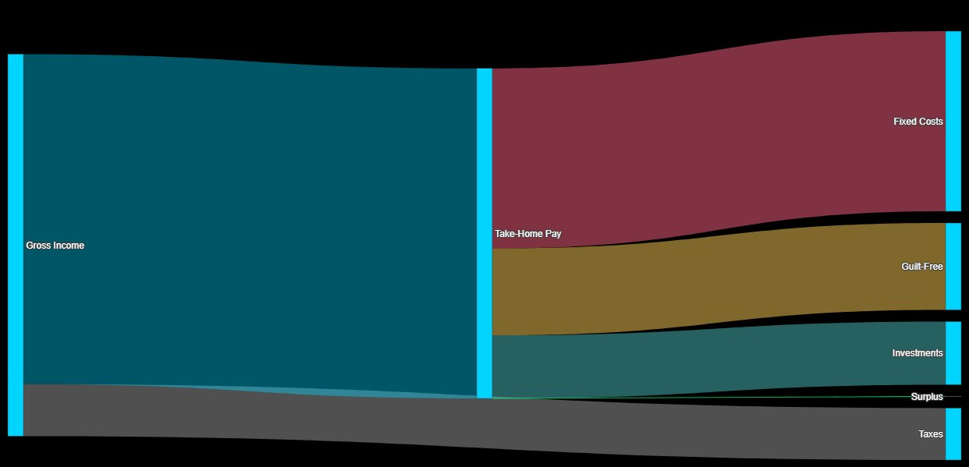
CASH FLOW SANKEY
Where is your money actually going? A Sankey forces you to confront it.
Cash Flow Sankey
Gross → Taxes → Take-Home → Fixed / Invest / Guilt-Free / Surplus
Node width proportional to actual dollar flow
LES-mode or formula-mode input
Deficit detection with red warning
Plotly go.Sankey, dark theme
Why a Sankey and not a pie chart? Sankey diagrams show flow and proportion simultaneously. A budget table tells you the numbers — a Sankey makes you feel them. When the "Surplus" node disappears or goes negative, the deficit is viscerally obvious. Built with Plotly go.Sankey on a dark theme so the colors pop and the flow reads immediately.
F.I.R.E. for Effect | OA3801
7
Notes:
Brandon: This is a beautiful display of what is the flow of your income. If you use a pie chart you are showing composition but you are not always detailing the income go which direction it is in. Sankey is interactive such that it will enable. Sankey is something that you would see on redddit or other platforms as people show the flow of their income.

Slide 16


LESSONS LEARNED/NOVELTY
Monte Carlo Complexity
GitHub Collaboration
Streamlit Limitations
Usage Analytics (Google Sheets)
TSP API Failure in Production
F.I.R.E. for Effect | OA3801
11
Notes:
Brandon: A standard Monte Carlo that is not dynamic requires.
Github collaboration.

Slide 17
LESSONS LEARNED/NOVELTY
Monte Carlo Complexity
Adding promotion-aware contributions, gliding lifecycle allocations, and per-fund parametric draws to an already complex simulation created cascading calibration issues. The seed-bias bug (S-fund at 8.6% vs ~55%) took days to isolate — the fix was switching from pool sampling to fresh Normal draws.
GitHub Collaboration
Merge conflicts in a 3,000-line+ single-file app were brutal. Learned the hard way to coordinate on sections, use branches, and avoid simultaneous edits to session_state keys. Next time: multi-page Streamlit architecture from day one.
Streamlit Limitations
Streamlit re-runs the entire script on every widget interaction. No partial re-renders, no component lifecycle. Complex tab interdependencies required careful session_state management and defensive defaults for every variable.
Usage Analytics (Google Sheets)
No built-in Streamlit analytics. Built anonymous tracking fingerprinting of User-Agent, logging to Google Sheets via gspread + service account credentials. Tracks: session duration, tabs visited, bounce rate, device type, MC runs, PDF downloads.
TSP API Failure in Production
TSP.gov blocked scraping when deployed to Streamlit Cloud. Built graceful fallback: calibrated parametric proxy using since-inception CAGR from tspfolio.com. Drift between live returns and FUND_STATS broke solver/MC alignment — removed live API entirely.
F.I.R.E. for Effect | OA3801
11
Notes:
Brandon: A standard Monte Carlo that is not dynamic requires.
Github collaboration.

Slide 18
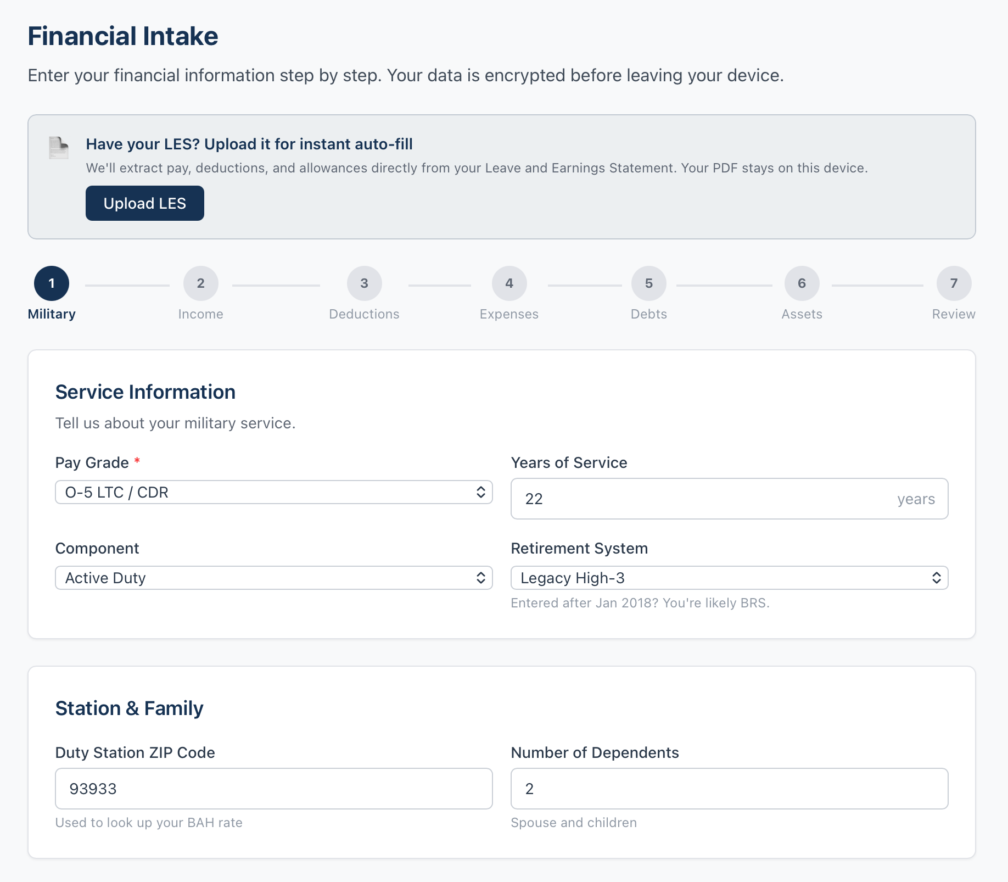
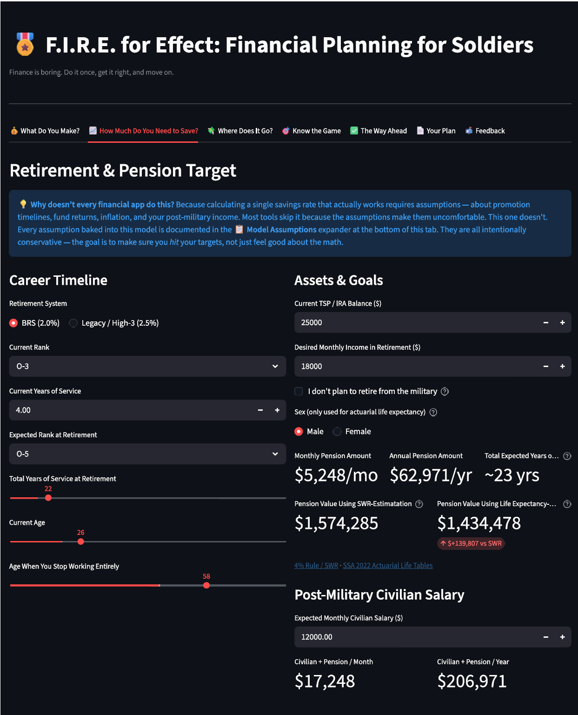
AI vs. Team Army
AI built a beautiful car: we built the engine.
(but also, we don't know how to put it in the car...)
AI-Generated App
Army-Generated App
F.I.R.E. for Effect | OA3801
10
Notes:
Brandon?

Slide 19
AI vs. Team Army
AI built a beautiful car: we built the engine.
(but also, we don't know how to put it in the car...)
AI-Generated App
Army-Generated App
What it can do:
Polished multi-step intake wizard — professional UI
JavaScript / HTML — designed for web/mobile
CAC authentication
Plaid API for live bank & account linking
Security scaffolding from day one
Compliance-aware architecture built in
Looks production-ready — fast
Has Monte-Carlo Visualizations
Tons of Additional Topics: PCS planner, deployment, transition, child considerations
What it can do:
Savings Rate solver → required savings rate
Promotion-aware, month-by-month income predictor
Monte Carlo with varying contributions and interest rates
SSA Actuarial Life Tables/SWR for pension valuation
Consent-gated anonymous analytics pipeline
F.I.R.E. for Effect | OA3801
10
Notes:
Brandon?

Slide 20
LIVE DEMO
F.I.R.E. for Effect | OA3801
Notes:
Ian

Slide 21
Go to the command line.
DEMO
01
pip install
Clone from my Github (ianmoss-dev): repo: fire-for-effect.
$
pip install \
download app.py + military_data.json — keep them in the same folder
streamlit pandas numpy altair plotly \
02
Open a terminal
matplotlib requests fpdf2 \
gspread google-auth yfinance
$
# drop the .json credentials file in
03
Might have to pip install
# the same folder as app.py
$
streamlit run app.py
04
streamlit run app.py
You can now view your Streamlit app in your browser.
Local URL:
http://localhost:8501
■ = new packages not in a typical Streamlit install

Slide 22

LIVE DEMO
fireforeffect.streamlit.app
F.I.R.E. for Effect | OA3801
Notes:
Ian

Slide 23
QUESTIONS?
FEEDBACK?
fireforeffect.streamlit.app
F.I.R.E. for Effect | OA3801

Slide 24
DASHBOARD ARCHITECTURE
Income
Calculator
Retirement
Goals
Budget
Allocator
Readiness
Quiz
Action
Plan
Feedback
& AAR
PDF
Export
Technology Stack
Core Capabilities
Python 3 + Streamlit — interactive web framework
Pandas + NumPy — data processing & numerical computation
Plotly + Matplotlib — interactive & static charts
JSON Data Store — 2026 military pay tables & BAH rates
gspread — anonymous analytics logging to Google Sheets
FPDF — downloadable PDF financial plan generation
Pay Engine — gross/net from rank, TIS, ZIP, 8+ special pays
Monte Carlo — 1,000-trial stochastic TSP projection
Savings Solver — binary search for optimal savings rate
Promotion Engine — month-by-month across 4 career chains
Cash Flow — Sankey: fixed / invest / guilt-free / surplus
Action Plan — gamified 9-step checklist with progress
~2,700
7
19
1,000
Lines of Python
Interactive Tabs
Quiz Questions
Monte Carlo Trials
F.I.R.E. for Effect | OA3801
13

Slide 25
KEY FINDINGS
What the tool reveals — even at MVP stage
$2,400+
$187K
4.25% vs 10.5%
per year
gap
returns
Average unclaimed BRS match
for E-5 (3% vs 5%)
Retirement gap for typical E-6
at 20 years on BRS pension alone
G-Fund vs C-Fund — the cost
of staying in default TSP
Key Takeaway: Even basic input exposes thousands of dollars in annual missed value. The problem isn't that servicemembers are bad with money — it's that no tool speaks their language.
F.I.R.E. for Effect | OA3801
12

Slide 26
